Slide 1
Biology
Sylvia S. Mader
Michael Windelspecht
Chapter 29 Vertebrate Evolution Lecture Outline
See separate FlexArt PowerPoint slides for all figures and tables pre-inserted into PowerPoint without notes.
Copyright 2022 © McGraw Hill LLC. All rights reserved. No reproduction or distribution without the prior written consent of McGraw Hill LLC.

Slide 2
Outline
29.1 The Chordates
29.2 The Vertebrates
29.3 The Fishes
29.4 The Amphibians
29.5 The Reptiles
29.6 The Mammals

Slide 3
29.1 The Chordates
  Four Main Characteristics
    Notochord
      Dorsal supporting rod located below nerve cord
    Dorsal Tubular Nerve Cord
      Protected by vertebrae
      Anterior portion becomes brain in most chordates
    Pharyngeal Pouches
      Aquatic vertebrates become gills
      Seen only as embryos in most vertebrates
      Terrestrial vertebrates modified for various purposes
    Postanal Tail
      Extends beyond the anus
      In humans, tail disappears in the embryo stage.
3

Slide 4
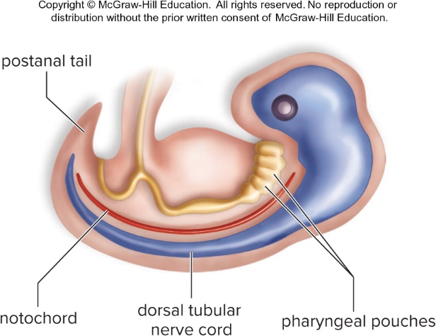
Characteristics of the Chordates
Figure 29.1
Access the text alternative for slide images.
4

Slide 5
Nonvertebrate Chordates
  Notochord persists and is never replaced by a vertebral column.
    Lancelets (Cephalochordates)
      Shallow marine environments, filter feeders, segmented
    Sea Squirts (Urochordates)
      Adults contain a thick outer covering (tunic).
      Marine organisms, filter feeders, bilateral symmetry
      Many biologists hypothesize that these organisms are directly related to the vertebrates.
        Larva may have become sexually mature without developing other adult characteristics.
5

Slide 6
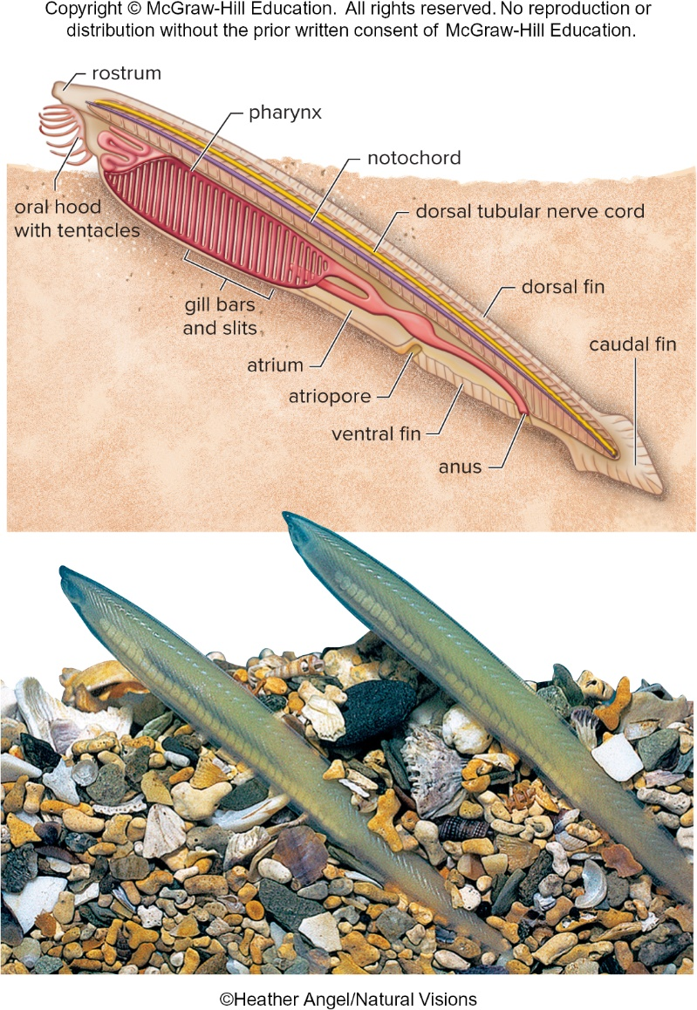
Lancelet, Branchiostoma
Figure 29.2
Access the text alternative for slide images.
(photo): ©Heather Angel/Natural Visions
6

Slide 7
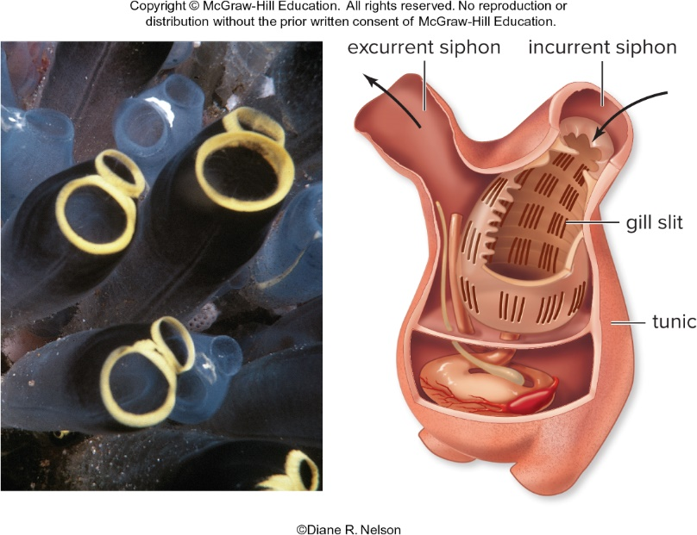
Sea Squirt, Clavelina
Figure 29.3
Access the text alternative for slide images.
(photo): Diane Nelson
7

Slide 8
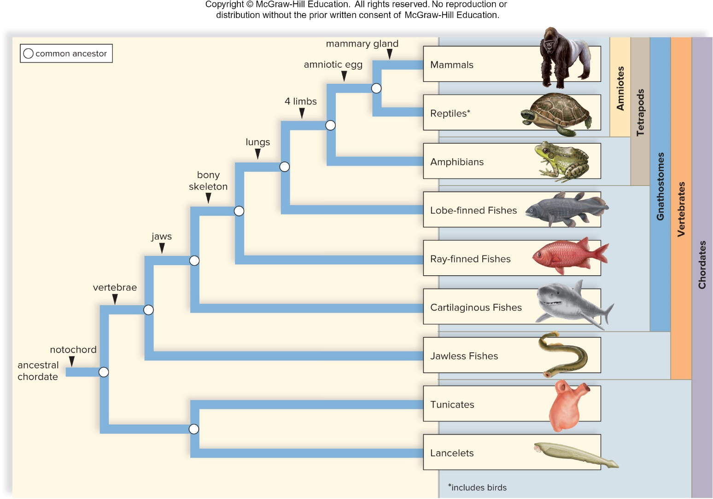
Phylogenetic Tree of the Chordates
Figure 29.4
Access the text alternative for slide images.
8

Slide 9
29.2 The Vertebrates
Characteristics of Vertebrates
  Vertebral column
    Replaces the embryonic notochord
    Evidence of segmentation
  Skull
    High degree of cephalization
    Encloses and protects brain
    Complex sense organs
  Endoskeleton
    Living tissue that grows with the animal
    Protection for internal organs
    Attachment for muscle
    Paired appendages characteristic
9

Slide 10
Internal Organization
    Large coelom and complete digestive tract
    Closed circulatory system
    Respiratory system consisting of gills or lungs
    Kidneys
      Serve as excretory and water-regulating organs that regulate water balance in the body
    Sexes are separate and reproduction is sexual.
10

Slide 11
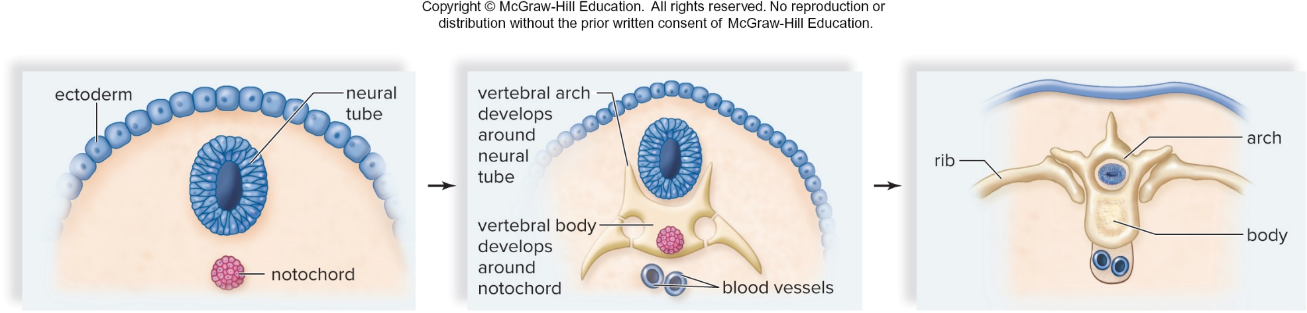
Replacement of the Notochord by the Vertebrae
Figure 29.5
Access the text alternative for slide images.
11

Slide 12
Vertebrate Evolution
Chordates appear 542 MYA, start of Cambrian
  End of Ordovician, jawless and jawed fishes
    Earliest vertebrates
  Jaws for predation
    Gnathostomes have jaws.
      Jawed fishes and all other invertebrates (end Silurian)
  Lungs and bony skeleton
    Adaptations for land existence
    Tetrapods with four limbs
      Amphibians evolved from bony fishes by the Devonian.
  Amniotes
    Produce amniotic egg that surrounds embryo in amniotic fluid
      Allows reproduction on land
12

Slide 13
29.3 The Fishes
  Approximately 28,000 species
    Largest group of vertebrates
  Aquatic, gill-breathing vertebrates
  Usually have fins and scale-covered skin
  Extensive fossil record
Jawless fishes (Agnathans)
  Ostracoderms – earliest vertebrate fossils
  Lampreys and hagfishes are modern-day jawless fishes that lack a bony skeleton.
  Parasitic sea lamprey demolished whitefish and trout in the Great Lakes.
13

Slide 14
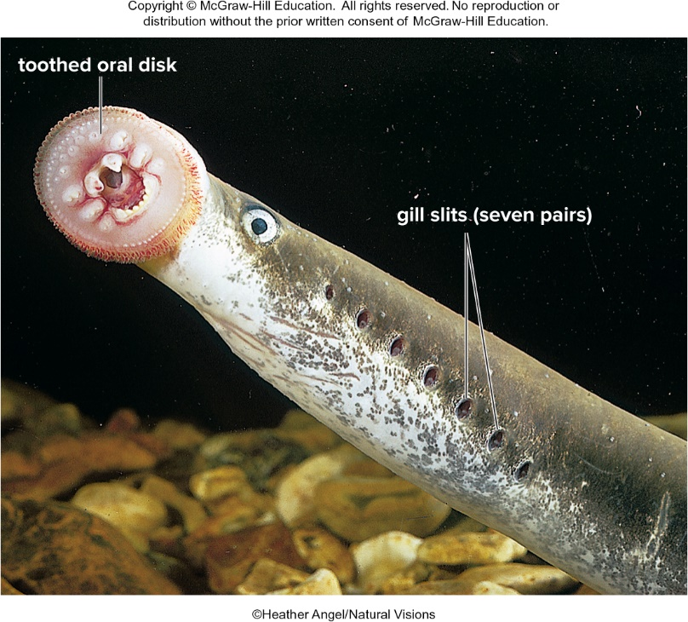
Lamprey
Figure 29.6
©Heather Angel/Natural Visions
14

Slide 15
Jawed Fish
  Fishes with jaws have these characteristics:
    Ectothermy
      Depend on environment to regulate their temperature
    Gills
    Cartilaginous or bony endoskeleton
    Scales
  Jaws evolved from the first pair of gill arches of agnathans.
  Placoderms
    Extinct jawed fishes of the Devonian period
    Thought to be ancestral to sharks and bony fish
15

Slide 16
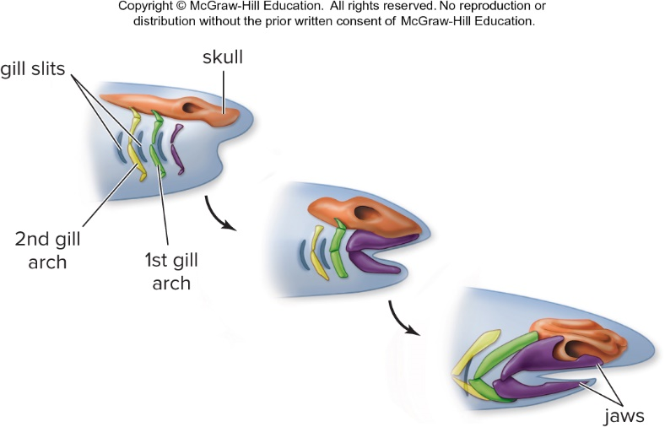
Evolution of the Jaw
Figure 29.7
Access the text alternative for slide images.
16

Slide 17
Cartilaginous Fishes 1
  Chondrichthyes have a skeleton of cartilage instead of bone.
    Sharks, rays, skates, chimaeras
    Lack gill cover of bony fishes
    Can sense electric currents in water
    Sharks and rays use a lateral line system.
    Filter feeders and predators
    In rays and skates, the pectoral fins are enlarged into large, winglike fins.
      Bodies are dorsoventrally flattened.
17

Slide 18
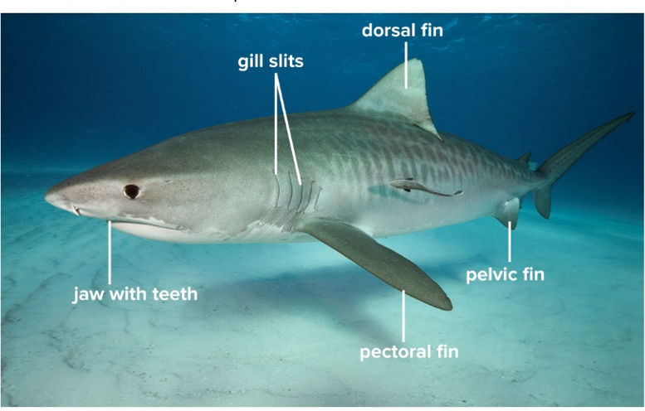
Cartilaginous Fishes 2
Tiger shark, Galeocerdovi cuer
Figure 29.8
Access the text alternative for slide images.
(a): Alastair Pollock Photography/Getty Images
18

Slide 19
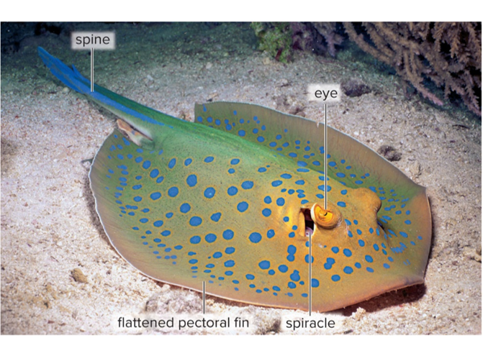
Cartilaginous Fishes – Stingray
Blue-spotted stingray, Taeniura lymma
Figure 29.8
Access the text alternative for slide images.
(b): Comstock Images/PictureQuest
19

Slide 20
Bony Fishes
  Osteichthyes have a skeleton of bone.
  25,000 species
    Most are ray-finned bony fishes.
    Lobe-finned fishes are a small subgroup with fleshy fins supported by central bones.
    Lacking external gill slits, gills are covered by an operculum.
    Swim bladder
      Gas-filled sac in bony fishes
      Pressure can be altered to change buoyancy.
    Well-developed brain and nervous system
    Separate sexes
    Majority of species undergo external fertilization.
20

Slide 21
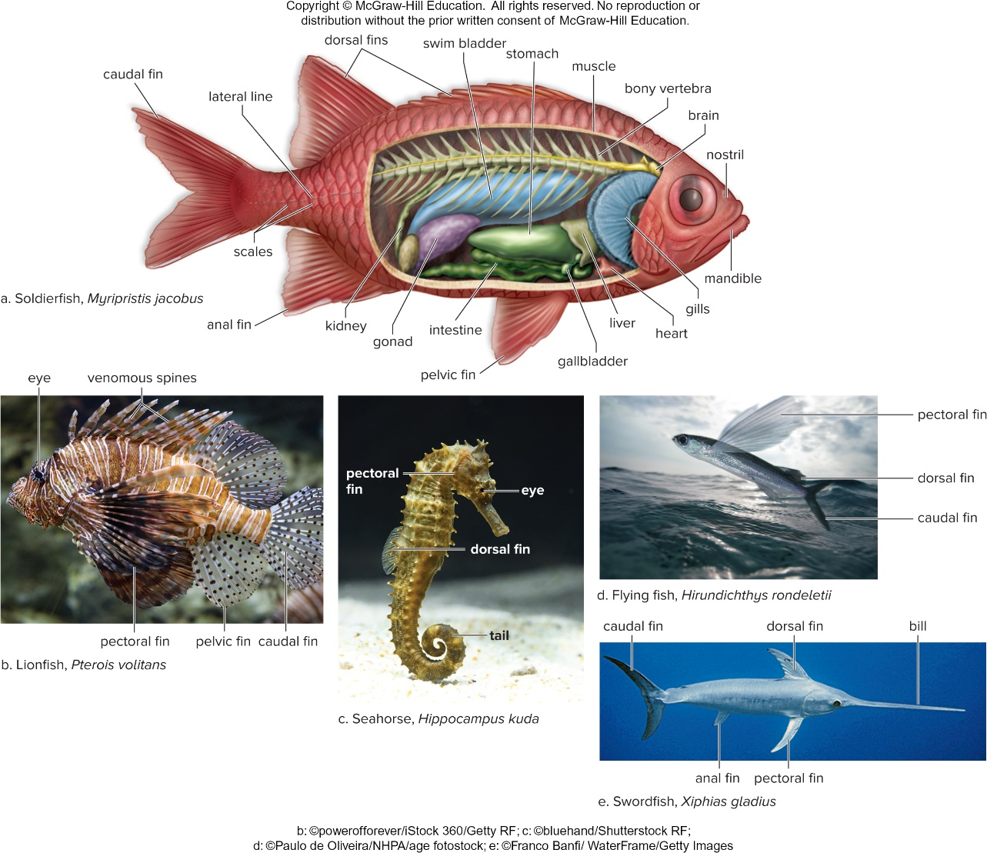
Ray-Finned Fishes
Figure 29.9
Access the text alternative for slide images.
(b): powerofforever/iStock 360/Getty Images; (c): bluehand/Shutterstock; (d): Paulo de Oliveira/NHPA/age fotostock; (e): Franco Banfi/WaterFrame/Getty Images
21

Slide 22
Lobe-Finned Fishes
  Possess fleshy fins supported by bones
  Gave rise to modern lobe-finned fishes and amphibians
  Lungfishes and coelacanths
    Modern-day lobe-finned fishes
    Lungfishes have lungs as well as gills.
    A coelacanth was caught in 1938, previously considered extinct.
22

Slide 23
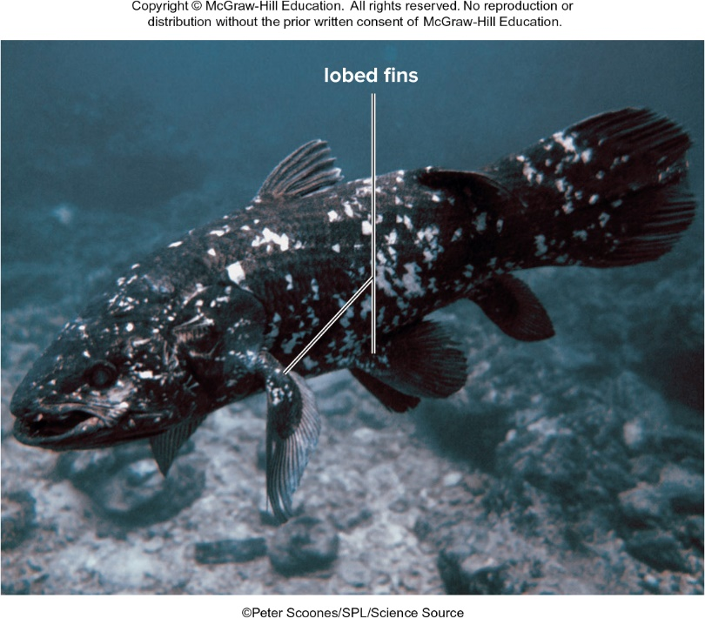
Coelacanth, Latimeria chalumnae
Figure 29.10
Peter Scoones/SPL/Science Source
23

Slide 24
29.4 The Amphibians
  Contain limbs
    Most are tetrapods.
  Smooth and nonscaly skin
  Lungs
    Usually present in adults
  Double-loop circulatory pathway with a three-chambered heart
  Sense organs
    Fine-tuned for life on land
  Ectothermy
  Aquatic reproduction
    Metamorphosis
24

Slide 25
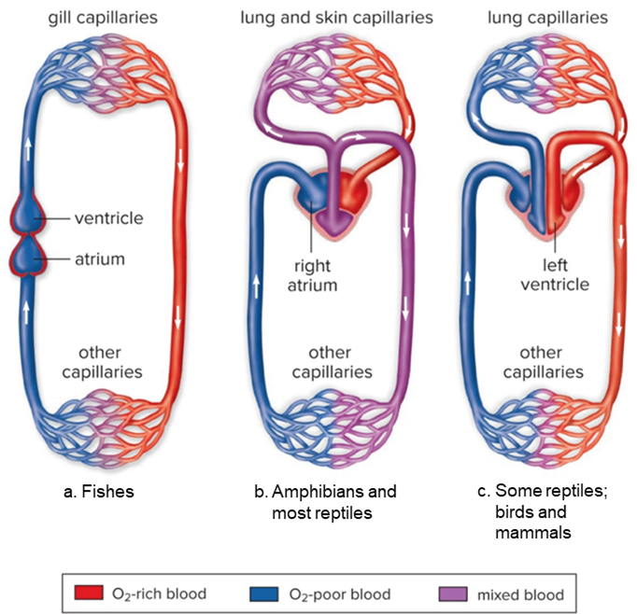
Vertebrate Circulatory Pathways
Figure 29.11
Access the text alternative for slide images.
25

Slide 26
Evolution of Amphibians
  Hypotheses of tetrapod evolution
    Lobe-finned fishes had an evolutionary advantage due to movement capability.
    Further adaptations promoted by:
      Supply of food on land and absence of predators
    Paleontologists found a transitional fossil, Tiktaalik roseae.
      Intermediate between lobe-finned fishes and tetrapods with limbs
        Provides insights on how tetrapod legs arose
26

Slide 27
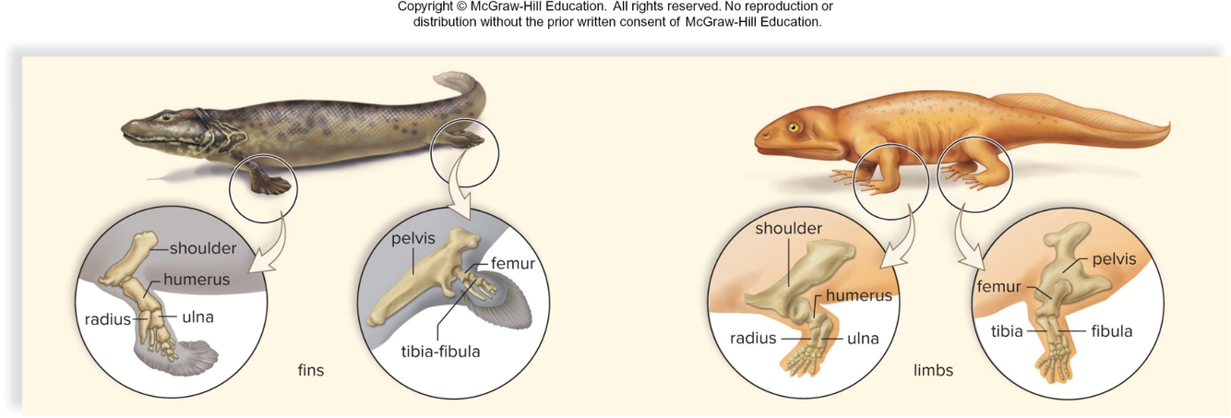
Lobe-Finned Fishes to Amphibians
Figure 29.12
Access the text alternative for slide images.
27

Slide 28
Diversity of Living Amphibians
Amphibians today occur in three groups:
  Salamanders and newts
    Salamanders practice internal fertilization.
  Frogs and toads
    Tailless as adults
  Caecilians
    Legless, sightless, worm shaped
28

Slide 29
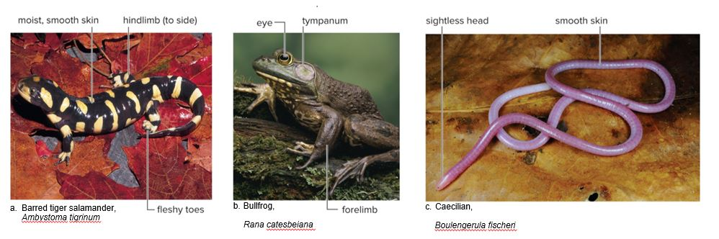
Amphibians
Figure 29.13
Access the text alternative for slide images.
(a): Suzanne L. Colins & Joseph T. Collins/Science Source; (b): T.Kitchin & V.Hurst/NHPA/Photoshot; (c): FLPA/Alamy Stock Photo
29

Slide 30
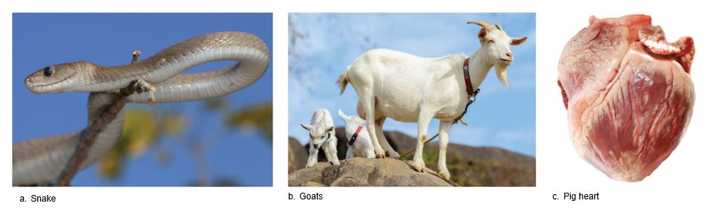
Medical Use of Animals
Figure 29A
(a): Marie Holding/iStock/Getty Images; (b): tomophotography/Moment/Getty Images; (c): Victoria Dolidovich/Hemera/Getty Images
30

Slide 31
29.5 The Reptiles
Reptiles (class Reptilia)
More than 20,000 species, including birds
  Characteristics
    Paired limbs
    Reptiles have a thick, scaly skin that is impermeable to water.
    Efficient breathing
      Lungs with expandable rib cage
    Efficient circulation
      Ventricle is partially or completely divided by a septum
    Efficient excretion
      Well-developed kidneys
    Ectothermy
    Well-adapted reproduction
      Internal fertilization
      Shelled amniotic egg
31

Slide 32
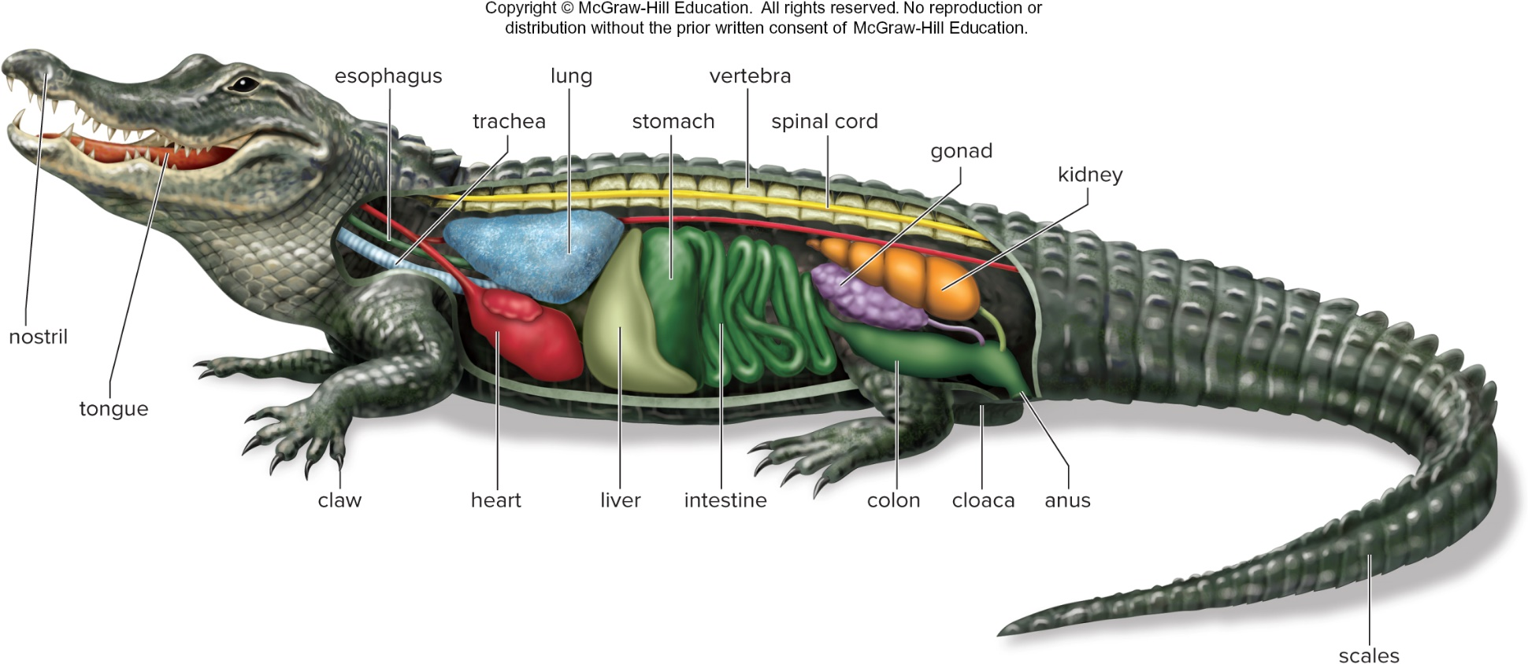
Reptilian Anatomy
Figure 29.14
Access the text alternative for slide images.
32

Slide 33
Evolution of Amniotes
  Thought to have evolved from amphibian ancestors by the Carboniferous period, 359 MYA
  Three lineages of amniotes
    Turtles – skull is anapsid
      Contains no openings behind the orbit
      Modern-day view of turtle evolution considers them highly specialized diapsids.
        This is still being debated.
    All other reptiles including birds – skull is diapsid
      Contains two openings behind the orbit
    Mammals – skull is synapsid
      Contains one opening behind the orbit
33

Slide 34
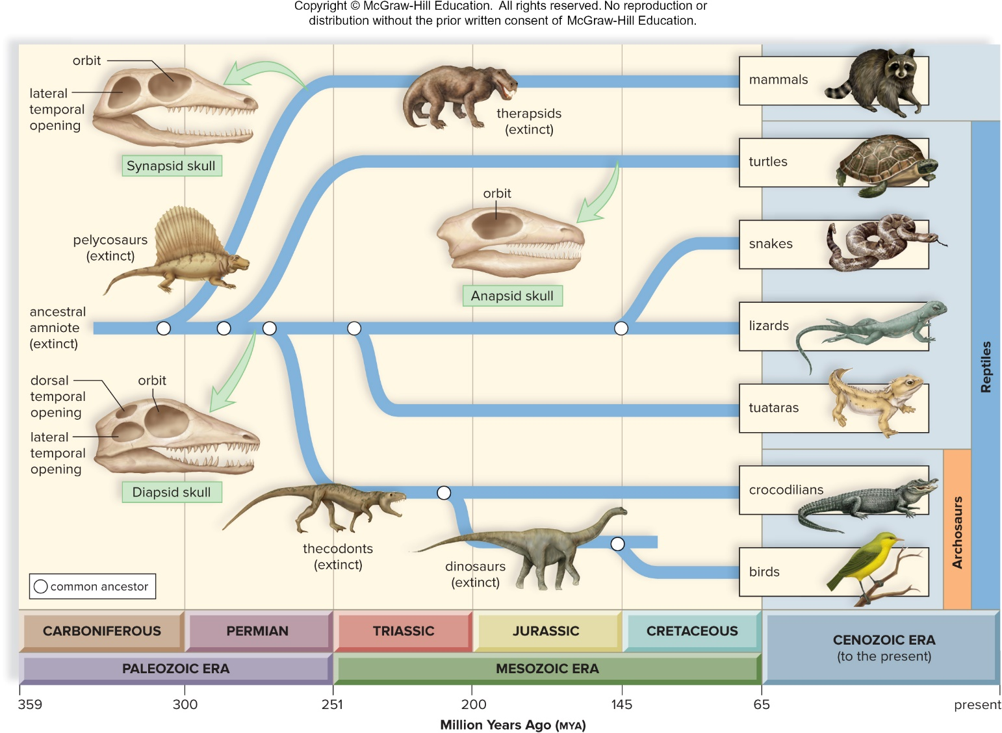
Timeline of the Evolution of the Amniotes
Figure 29.15
Access the text alternative for slide images.
34

Slide 35
Diversity of Living Reptiles
  Turtles and tortoises
    Ribs and thoracic vertebrae fused into a heavy shell
    Lack teeth but have a sharp beak
  Lizards
    Most have four clawed feet.
    Carnivorous
  Snakes
    Lost limbs as an adaptation for burrowing
    Carnivorous
    Some are venomous.
  Tuataras
    Third eye
    Only member of ancient group that included common ancestor of modern lizards and snakes
  Crocodilians
    Long, powerful jaws
    Muscular tail used as a weapon and a paddle
35

Slide 36
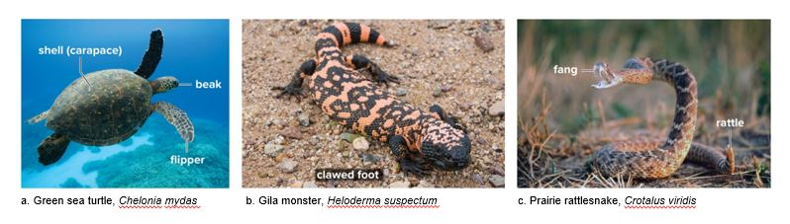
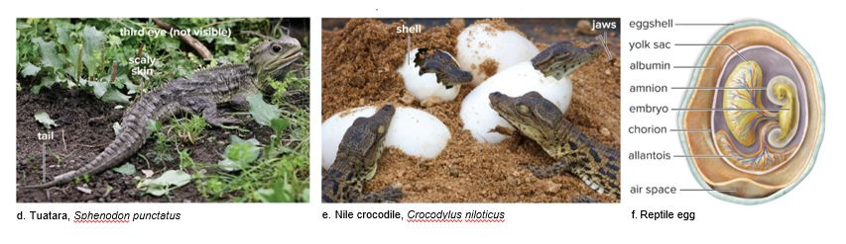
Reptilian Diversity Other Than Birds
Figure 29.16
(a): Paul Souders/Digital Vision/Getty Images; (b): Design Pics/Superstock; (c): Steve Hamblin/Alamy Stock Photo; (d): Tim Cuff/Alamy Stock Photo; (e): Heinrich van den Berg/Gallo Images/Getty Images
36

Slide 37
Birds
Plentiful fossil record shows birds evolved from dinosaurs.
  Characteristics:
    Feathers
      Modified reptilian scale with a complex structure
    Modified skeleton
      Collarbone and many other bones are fused.
      Sternum has a keel
    Modified respiration
      Lungs are connected to air sacs.
    Endothermy
    Well-developed sense organs and nervous system
      Acute vision
      Instinctual behavior
37

Slide 38
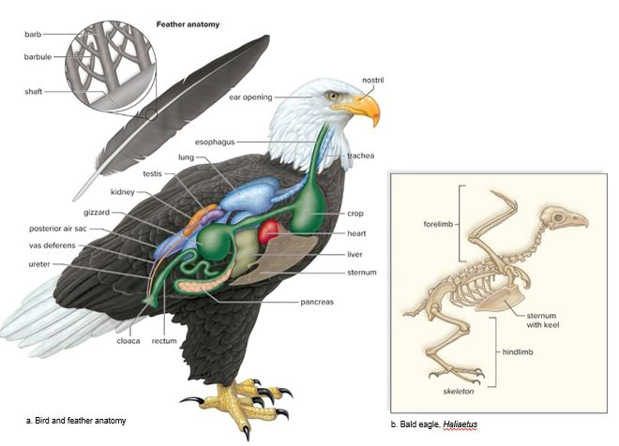
Bird Anatomy and Flight
Figure 29.17
Access the text alternative for slide images.
38

Slide 39
Diversity of Living Birds
  Most can fly.
    Examples: eagles, geese, mockingbirds
  Some are flightless.
    Examples: emus, penguins, kiwis, ostriches
  Typically classified according to beak and foot type, habitat, and behavior
39

Slide 40
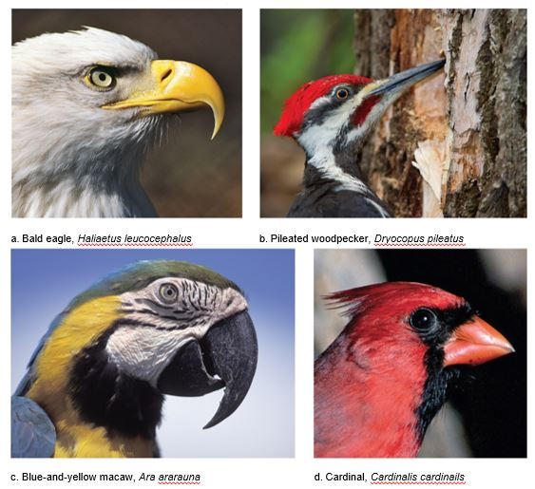
Bird Beaks
Figure 29.18
Access the text alternative for slide images.
(a): Dale DeGabriele/Getty Images; (b): DanielParent/Getty Images; (c): Ingram Publishing/Superstock; (d): Gary W. Carter/Corbis Documentary/Getty Images
40

Slide 41
29.6 The Mammals
Mammals (class Mammalia)
  Characteristics:
    Hair
    Milk-producing mammary glands
    Skeleton
      Mammalian skull accommodates a larger brain relative to body size.
      Differentiated teeth
    Internal organs
      Efficient respiration and circulation
      Double-loop circulatory pathway with a four-chambered heart
      Kidneys adapted to conserve water
      Highly developed nervous system
    Internal development in most mammals
41

Slide 42
The Evolution of Mammals
  Mammals share an amniote ancestor with reptiles.
    Immediate ancestors had a synapsid skull.
  First true mammals appeared during the Triassic period.
    Co-existed with the dinosaurs
  Common ancestor of all mammal groups appeared in the late Triassic/early Jurassic period (220 MYA).
  Monotremes are the earliest mammalian group.
  Placental mammals underwent adaptive radiation into habitats previously belonging to dinosaurs.
42

Slide 43
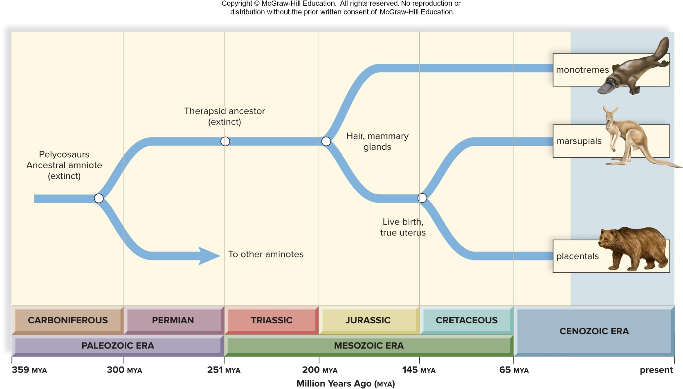
Timeline of the Evolution of Mammal Groups
Figure 29.19
Access the text alternative for slide images.
43

Slide 44
Three Lineages
Monotremes
  Hard-shelled amniotic eggs
  Single urogenital opening (cloaca)
Marsupials
  Females contain pouch
Placental mammals
  Placenta is used for the exchange of maternal and fetal blood.
44

Slide 45
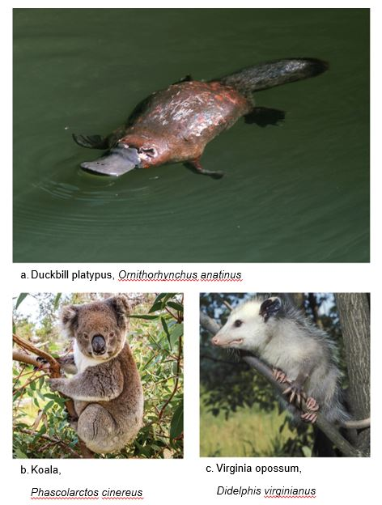
Monotremes and Marsupials
Figure 29.20
(a): worldslifewonders/Shutterstock; (b): John White Photos/Moments/Getty Images; (c): John Macgregor/Photolibrary/Getty Images
45

Slide 46
Orders of Placental Mammals
Table 29.2 Orders of placental mammals
Order | Examples | Traits
Cetacea | Whales, dolphins | Marine, no fur, streamlined bodies
Artiodactyla | Cattle, deer, antelope | Even-toed ungulates, horns or antlers, ruminants
Perissodactyla | Horses, rhinoceroses | Odd number toes, nonruminants
Carnivora | Dogs, cats, weasels, minks, stoats | Meat eaters, long canines
Pholidota | Pangolins | Scaly armor, no teeth
Chiroptera | Bats | Fly with membranous wings, some echolocate
Erinaceomorpha | Hedgehogs | Spines, insectivores
Soricomorpha | Shrews, moles | Small, high metabolism, insectivorous
Rodentia | Mice, rats, voles, beavers, squirrels | One pair of specialized incisors that grow continuously
Lagomorpha | Rabbits, hares | Two pairs of incisors that grow continuously, long hindlimbs
Dermoptera | Colugos ("flying lemurs") | Membrane between hands and feet
Scandentia | Tree shrews | Large forward-facing eyes, grasping hand
Primates | Monkeys, apes | Opposable thumb, developed brains, social
Xenarthra | Sloths, armadillos | Special projections on the spine
Afrocoricida | Golden moles, tenrecs | Insectivores
Macroscelidia | Elephant shrews | Small, long snout, long hindlimbs
Tubulidentata | Aardvarks | Insectivore, long snout, coarse fur
Sirenia | Manatees, dugongs | Marine, long whiskers
Hyracoidea | Hyraxes | Small mammals
Proboscidea | Elephants | Largest land mammals, trunk, tusks
Table divided into three columns summarizes orders of placental mammals with examples and traits. The column headers are marked from left to right as: Order, examples, and traits.
46

Slide 47
End of main content
Copyright 2022 © McGraw Hill LLC. All rights reserved. No reproduction or distribution without the prior written consent of McGraw Hill LLC.

Slide 48
Accessibility Content: Text Alternatives for Images

Slide 49
Characteristics of the Chordates - Text Alternative
Return to parent-slide containing images.
All chordates have four distinctive traits that are present at some stage of their life cycle.
Return to parent-slide containing images.

Slide 50
Lancelet, Branchiostoma - Text Alternative
Return to parent-slide containing images.
The body consists of rostrum, oral hood with tentacles and laterally textured pharynx in the front, long notochord, gill bars and slits, dorsal tubular nerve cord and atrium in the center; and atriopore, dorsal fin, ventral fin and opening of anus at the back.
Return to parent-slide containing images.

Slide 51
Sea Squirt, Clavelina - Text Alternative
Return to parent-slide containing images.
Note that the only chordate characteristic remaining in the adult is gill slits.
Return to parent-slide containing images.

Slide 52
Phylogenetic Tree of the Chordates - Text Alternative
Return to parent-slide containing images.
Common ancestral chordate branches into animals species as: mammals and reptiles.
Common eukaryotic ancestor branches into tetrapods species as: amphibians.
Common eukaryotic ancestor branches into gnathostomes species as: lobe-finned fishes, ray-finned fishes and cartilaginous fishes.
Common eukaryotic ancestor branches into vertebrates species as: jawless fishes.
Common eukaryotic ancestor branches into chordates species as: tunicates and lancelets.
Return to parent-slide containing images.

Slide 53
Replacement of the Notochord by the Vertebrae - Text Alternative
Return to parent-slide containing images.
The stages are as follows:
The circular notochord is visible under the ovular neural tube within the layer of ectoderm.
Vertebral body develops around notochord, with a vertebral arch developing around neural tube. The blood vessels are visible during this stage.
A lateral rip is developed, with completely developed arch around the neural tube. A vertebrae body is visible with blood vessels inside it.
Return to parent-slide containing images.

Slide 54
Evolution of the Jaw - Text Alternative
Return to parent-slide containing images.
The first jaw evolved from the first and second gill arches of fishes.
Return to parent-slide containing images.

Slide 55
Cartilaginous Fishes 2 - Text Alternative
Return to parent-slide containing images.
This tiger shark has a prominent dorsal fin, a pair of pectoral fins extending from the sides of the body just behind the gill slits, and a pair of pelvic fins located near the posterior end of the body.
Return to parent-slide containing images.

Slide 56
Cartilaginous Fishes – Stingray - Text Alternative
Return to parent-slide containing images.
The pectoral fins are greatly enlarged into a pair of large, winglike fins running the length of the sides of the flattened body. The eyes sit on top of the body, openings called spiracles sit behind the eyes, and a tail with a spine extends from the posterior end of the body.
Return to parent-slide containing images.

Slide 57
Ray-Finned Fishes - Text Alternative
Return to parent-slide containing images.
A) Soldierfish (Myripristis jacobus):
Cutaway diagram of soldierfish shows a nostril, mandible, circular gills, brain, lateral bony vertebra in the front, liver, gallbladder, large stomach, swim bladder, pointed ovular gonad, thin kidney and muscles in the center; and lateral line, textured scales, dorsal, anal and caudal fins at the back.
B) Lionfish (Pterois volitans):
The body shows eye in the front, venomous spines and pectoral fin in the center and pelvic and caudal fin at the back.
C) Seahorse (Hippocampus kuda):
The body shows pectoral fin and eye in the front, dorsal fin in the center and spirally twisted tail at the back.
D) Flying fish (Hirundichthys rondeletii):
The body shows pectoral fin in the front, dorsal fin in the center and caudal fin at the back.
E) Swordfish (Xiphias gladius):
The body shows laterally long bill in the front, dorsal and pectoral fin in the center; and anal and caudal fin at the back.
Return to parent-slide containing images.

Slide 58
Vertebrate Circulatory Pathways - Text Alternative
Return to parent-slide containing images.
a. The single loop pathway of fishes has a two-chambered heart which shows transfer of blood from atrium to ventricle to gill capillaries to other capillaries and back to atrium.
b. The double-loop pathway of amphibians and most reptiles sends blood from right atrium to the lungs and then to the body passing through other capillaries.
c. The four-chambered heart of some reptiles (birds and mammals) sends only oxygen-poor blood to the lungs and oxygen-rich blood from left ventricle to the body.
Return to parent-slide containing images.

Slide 59
Lobe-Finned Fishes to Amphibians - Text Alternative
Return to parent-slide containing images.
Transitional form:
Anterior fins:
It consisted of shoulder, humerus, radius and ulna.
Posterior fins:
It consisted of long pelvis, femur and conjoint tibia-fibula.
Ancestral amphibian:
Anterior limbs:
It consisted of shoulder, humerus, radius and ulna.
Posterior limbs:
It consisted of short pelvis, femur and separated tibia and fibula.
Return to parent-slide containing images.

Slide 60
Amphibians - Text Alternative
Return to parent-slide containing images.
A) Barred tiger salamander (Ambystoma tigrinum):
The body shows moist, smooth skin in the front, hindlimb (to side) in the center and fleshy toes at the back.
B) Bullfrog (Rana catesbeiana):
The body shows eye and circular tympanum in the front and forelimb in the center.
C) Caecilian (Boulengerula fischeri):
The body shows sightless head in the front and smooth skin across the long and slender body surface.
Return to parent-slide containing images.

Slide 61
Bird Anatomy and Flight - Text Alternative
Return to parent-slide containing images.
A) Bird and feather anatomy:
Anterior body:
The body in the front shows nostril, ear opening, tube-like esophagus and trachea.
Central body:
The body in the center shows triangular lung, ovular testis, slender kidney, spherical gizzard, irregular triangular sternum and liver, triangular heart and sac-like crop.
Posterior body:
The back of the body shows posterior air sac, vas deferens, ureter, cloaca, rectum and spherically textured pancreas.
B) Bald eagle (Haliaetus):
The skeletal structure shows a forelimb in the front, sternum with keel in the center and hindlimb at the back.
Return to parent-slide containing images.

Slide 62
Reptilian Anatomy - Text Alternative
Return to parent-slide containing images.
Front body:
The body in the front shows nostril, tongue, tube-like esophagus and trachea; and claws.
Central body:
The body in the center shows triangular lung, sac-like stomach, longitudinally sectioned vertebra, lateral spinal cord, spherically textured gonad, spirally textured kidney, irregularly ovular heart and liver, folded intestines, colon, cloaca and anus.
Back body:
The back of the body shows a scaled tail with a tip end.
Return to parent-slide containing images.

Slide 63
Timeline of the Evolution of the Amniotes - Text Alternative
Return to parent-slide containing images.
The data from 359 to present (in million years ago) is as follows:
359 to 300:
Carboniferous:
Ancestral amniote (extinct) branches into mammals and turtles (reptiles).
300 to 251:
Permian:
Ancestral amniote (extinct) branches into turtles (reptiles).
300 to 251:
Permian:
Ancestral amniote (extinct) branches into crocodilians and birds (Archosaurs)
251 to 200:
Triassic:
Ancestral amniote (extinct) branches into lizards and tuataras (reptiles).
200 to 145:
Jurassic:
Ancestral amniote (extinct) branches into birds (Archosaurs).
145 to 65:
Cretaceous:
Ancestral amniote (extinct) branches into snakes and lizards (reptiles).
Return to parent-slide containing images.

Slide 64
Timeline of the Evolution of Mammal Groups - Text Alternative
Return to parent-slide containing images.
The data from 359 to present (in million years ago) is as follows:
359 to 300:
Carboniferous:
Pelycosaurs Ancestral amniote (extinct) branches into monotremes, marsupials, placentals and other aminotes.
251:
Between permian and triassic:
Therapsid ancestor (extinct) branches into monotremes, marsupials and placentals.
Return to parent-slide containing images.

Slide 65
Bird Beaks - Text Alternative
Return to parent-slide containing images.
a) Bald eagle has large hooked beak.
b) Woodpecker has sharp pointed beak.
c) Macaw has short, curved beak.
d) Cardinal has short, fat beak shaped like cones.
Return to parent-slide containing images.

